Slide 1
NATO Strategic Communications Centre of Excellence

Slide 2
Our ambition
To support the Alliance and other international organizations, NATO Member and Partner Nations by:
facilitating efficient adaptation to dynamically changing information environment
addressing the future challenges and finding solutions for current shortfalls
providing forum for experience and expertise sharing
building network of trained Strategic Communications practitioners
promoting Strategic Communications mindset

Slide 3
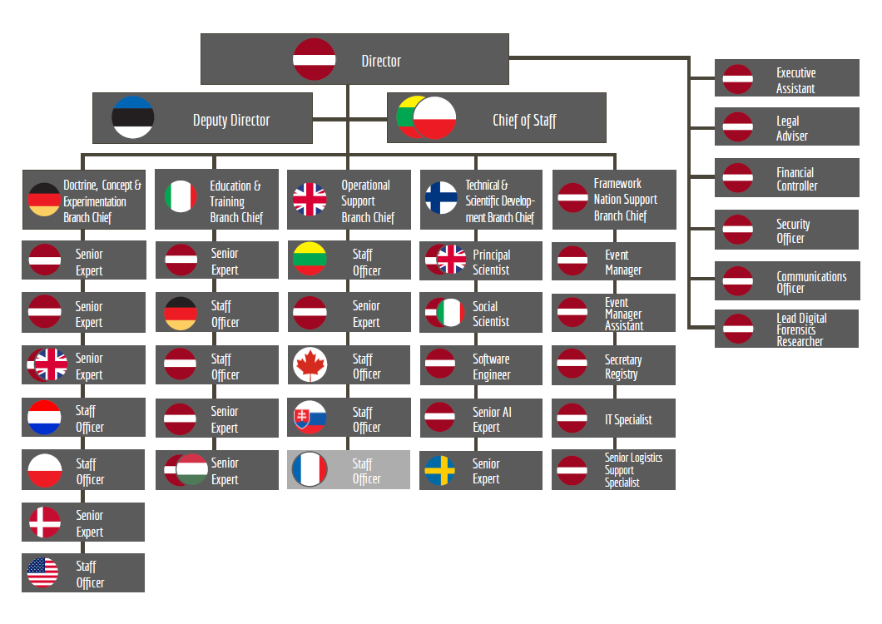

Slide 4
Major events 2021
Riga Stratcom Dialog 6-7 May (online) – more than 1000 participants
Social Media Seminar 7 June (online) – over 600 participants
Social Media Course
16 #StratcomTalks webinars
More than 80 events supported by the CoE (seminars, lectures, exercises, conferences workshops etc.)

Slide 5
Publications 2021
Inoculation Theory and Misinformation
Russia's Footprint in the Western Balkan Information Environment: Susceptibility to Russian Influence
Russian Media Landscape: Structures, Mechanisms, and Technologies of Information Operations
Robotrolling 2021
Strategic Communications Hybrid Threats Toolkit
Georgia’s Information Environment through the Lens of Russia’s Influence
How Did The Nordic-Baltic Countries Handle The First Wave of COVID-19?
Russia's Strategy in Cyberspace
China’s Social Credit System: Current Status, Role of Data and Surveillance, and Influence Outside of China
The Future is Now
Exercise Kavkaz 2020 - a final test of Russian military reform?
Russia's Activities in Africa's Information Environment
Abuse of power: coordinated online harassment of Finnish government ministers
Notes:
Reports under review and being published soon.
21-25 FIN case study (mask case)
21-39 WeChat
21-54 Framework to evaluate NATO allies resilience to disinformation will be published soon.
21-63 Event on Government Sector Experiences in StratCom is planned on 17DEC 2021 in Stockholm.

Slide 6
Extremist communication capabilities in North Africa and the Sahel
Social Media Monitoring: A Primer
Academic journal “Defence Strategic Communications” Vol 9
Fact-checking and Debunking
Falsification of History as a Tool of Influence
Belarus protests: Information Control and Technological Censorship
Data Brokers and Security
Terrorist and Armed Groups in the Fezzan-Sahel Region: Recruitment and Communication Tactics
RUS communication in the Middle East: the case of intervention in the Syrian conflict
Impact of 5G development to the disinformation
RUS information campaign against the world and Ukraine and its occupied territories in 2021
CHN information influence activities playbook. CHN narratives and modus operandi on narratives towards NATO
Psychological safety and resilience of society in the age of social media and moral panics
Mapping Social Media Platforms Techniques and Reach
Disinformation media literacy education and training concept
Seminar on commercial sector challenges at information age
Notes:
Reports under review and being published soon.
21-25 FIN case study (mask case)
21-39 WeChat
21-54 Framework to evaluate NATO allies resilience to disinformation will be published soon.
21-63 Event on Government Sector Experiences in StratCom is planned on 17DEC 2021 in Stockholm.

Slide 7
Projects 2022
22-2 Robotic networks in social media
22-6 StratCom lessons from COVID19 crisis
22-9 Defence Communicators in the V4 region
22-14 National Structures, Methods and Common Practices in NATO Military Public Affairs
22-22 Update on social media monitoring tools and web application development
22-31 Weaponized or Empowered? The ethics, implications and options of equipping populations to conduct Information conflict
22-37 Effects of RUS and CHI Information Influence Activities in NATO:s information environment
22-43 Sports Diplomacy as Political Tool
22-48 NATO Information Activity Legitimacy and Approval Procedure in the Digital Age
22-49 The Alliance´s Communication Cultures
22-53 Representation of RF major exercises Kavkaz, Tsentr, Zapad and Vostok in the information environment
22-58 Arctic Narratives
22-61 Defining Capability in Countering Foreign Interference
22-63 Information Environment Assessment Handbook
22-64 NATO StratCom Handbook
Notes:
Reports under review and being published soon.
21-25 FIN case study (mask case)
21-39 WeChat
21-54 Framework to evaluate NATO allies resilience to disinformation will be published soon.
21-63 Event on Government Sector Experiences in StratCom is planned on 17DEC 2021 in Stockholm.

Slide 8
The Faces of Fake News By Andrew Park and al
Non Info irrelevant | Dis Info Manipulation of info
Mis Info negligence | Mal Info Reality-based
Intent to Deceive
Intent to Harm

